Slide 1

Smart Grid Monitoring

Slide 2
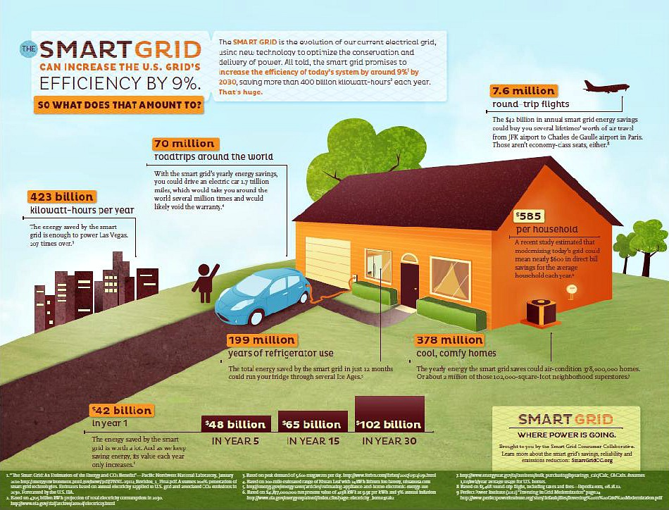

Slide 3
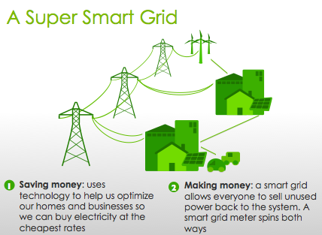
Benefits

Slide 4

Smart Grid

Slide 5
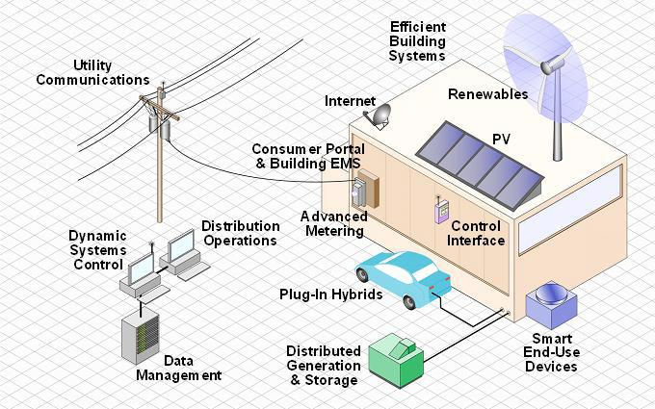

Slide 6
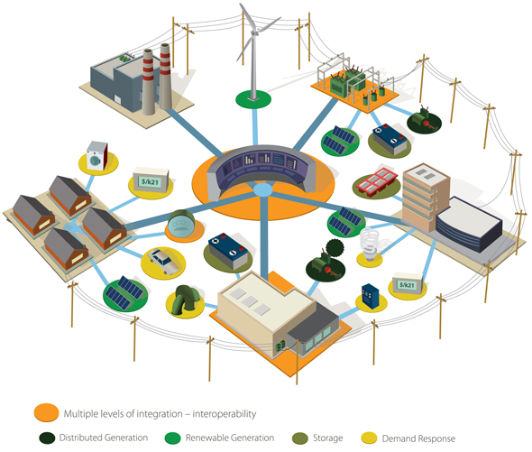

Slide 7
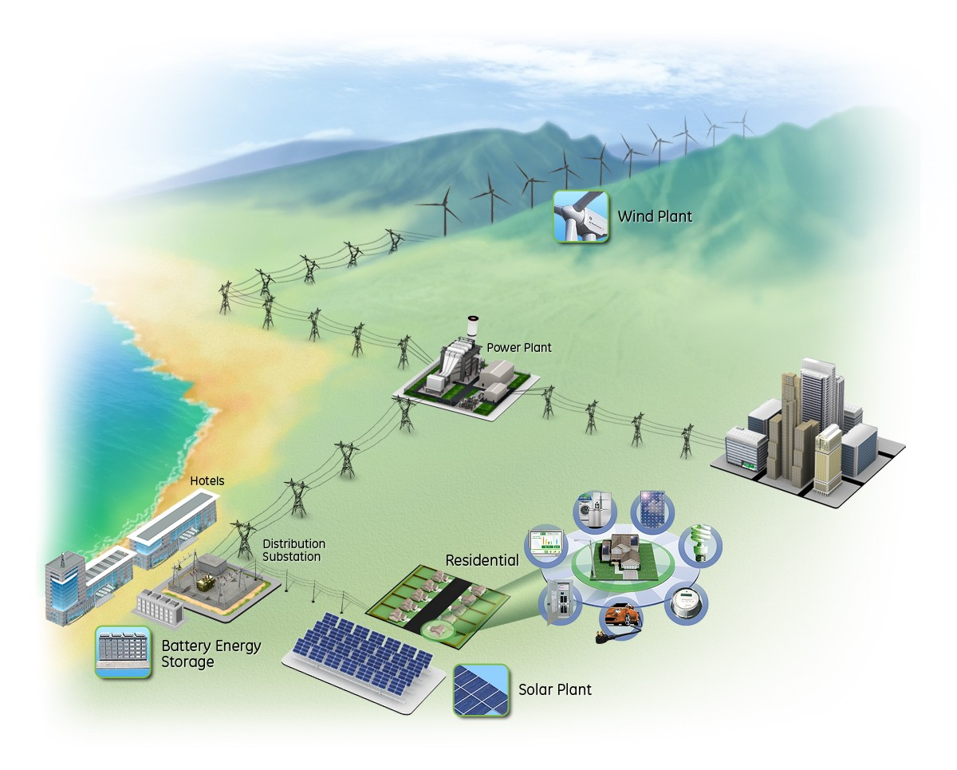

Slide 8
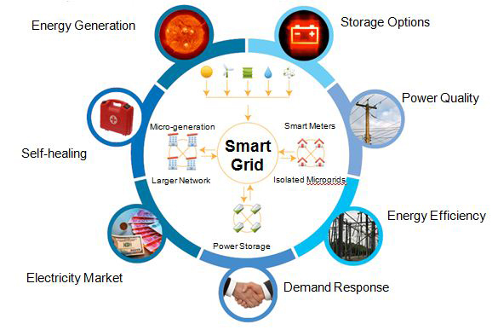
Features

Slide 9
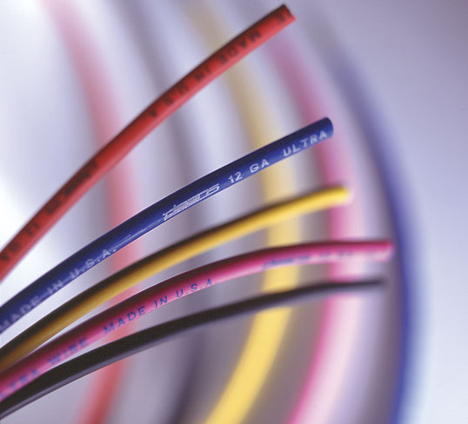
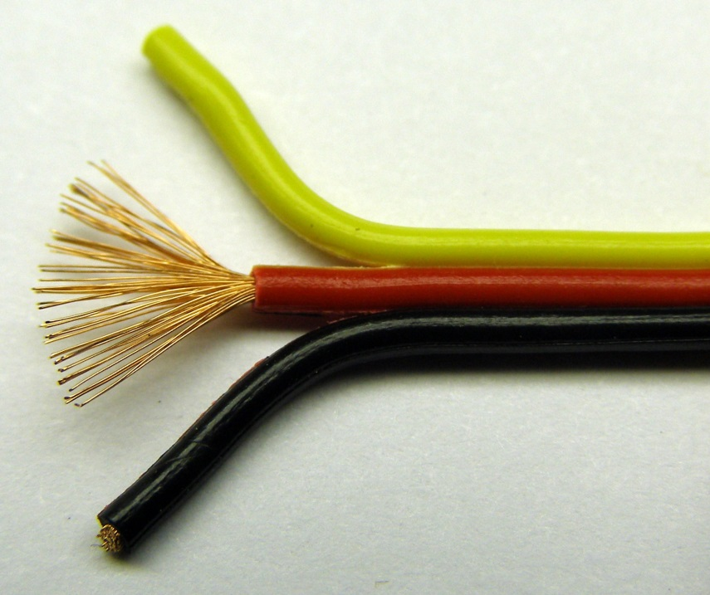
Power Buses used in a Smart Grid
AC Bus
Connects to:
AC Sources
AC Loads
AC – DC Converters
DC Bus
Connects to:
DC Sources
DC Loads
DC Storage (batteries)
DC – AC Converters

Slide 10


Requirements
Monitoring
Helps:
Consumers to understand the costs due to their appliances, identify devices consuming high power, thus helping them to reduce electric bill costs.
Allow researchers and industrialists to understand the energy usage pattern of consumers and accordingly engineer devices to enhance energy savings.
Empowers people to sell unused/generated energy to grid, store energy for peak hours.
Control
Helps:
Consumers to easily control their appliances, from anywhere in the world.
Control automation can lead to tremendous saving when the grid can automatically turn off devices to save energy. It can also be used to design self-healing electricity networks, thus ensuring reliability.
Control energy flow in the best possible way so as to minimize energy loss.

Slide 11
Steps to Smart Grid Monitoring

Slide 12
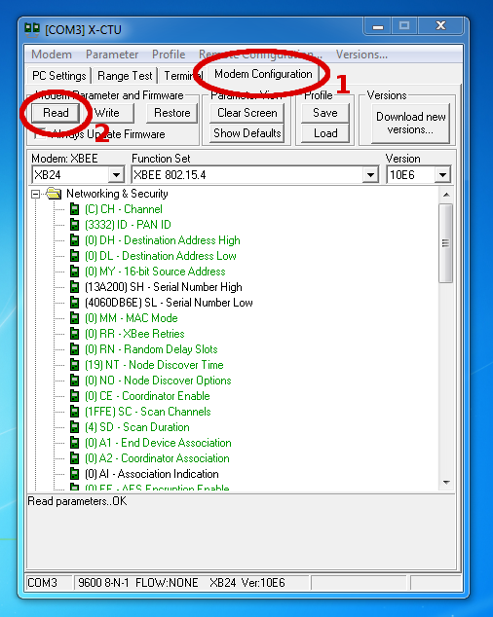
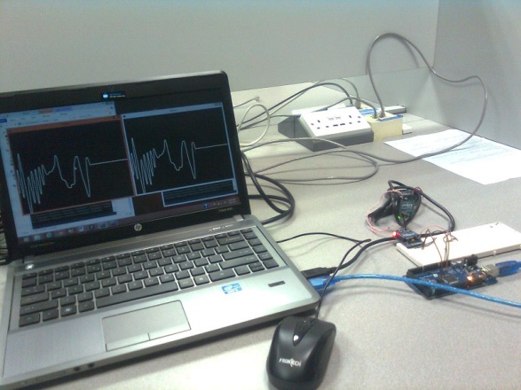
Sending and Receiving Manually generated signals wirelessly

Slide 13
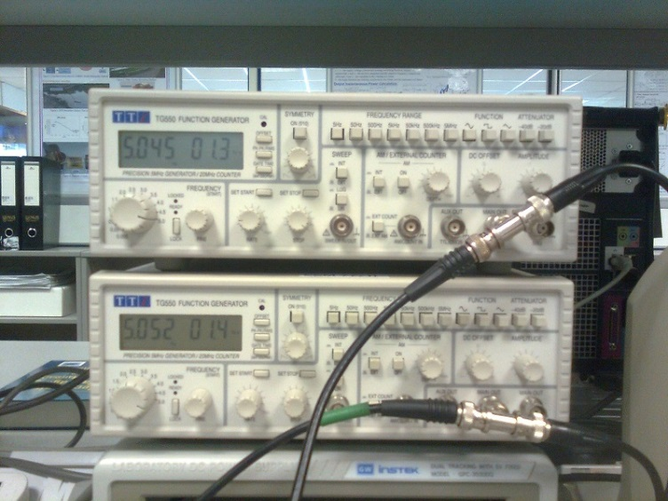
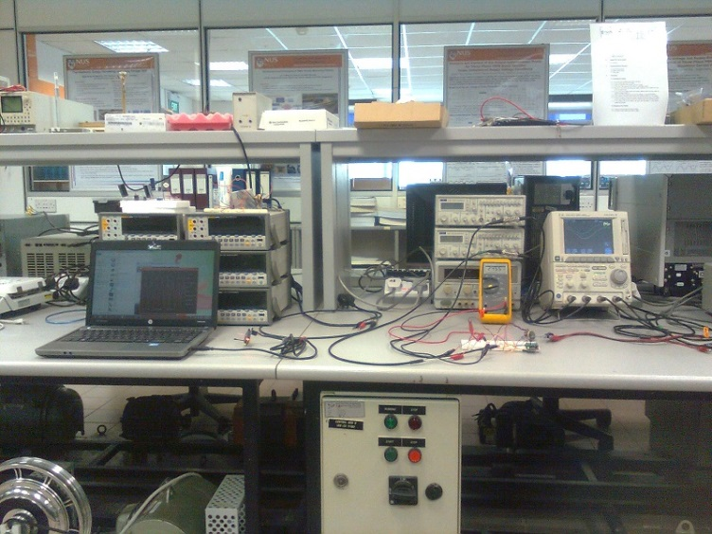
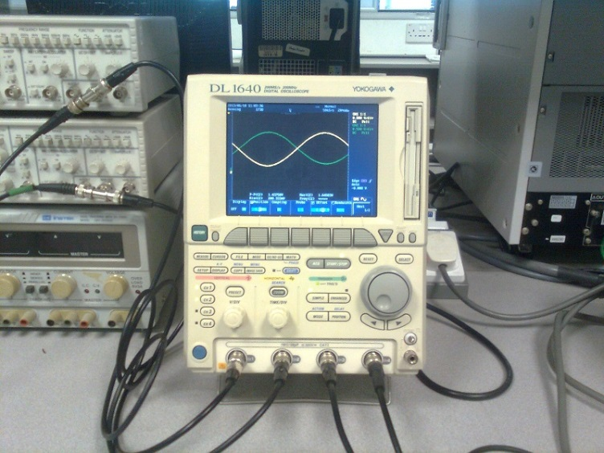
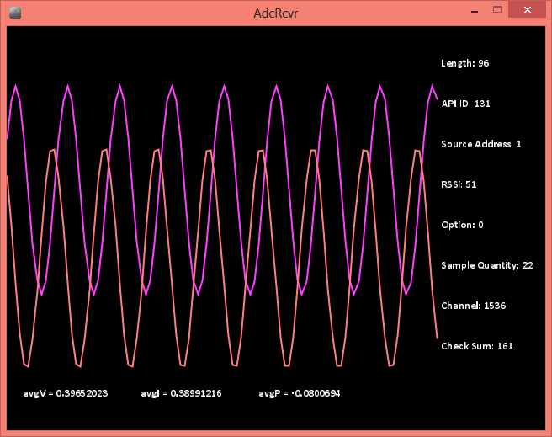
Monitoring Analog Signals wirelessly (using Xbee ADC)

Slide 14
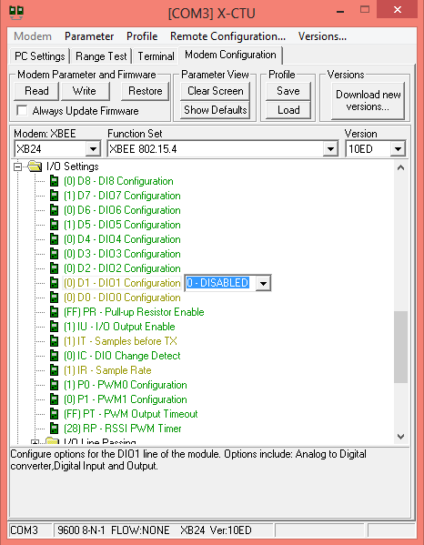
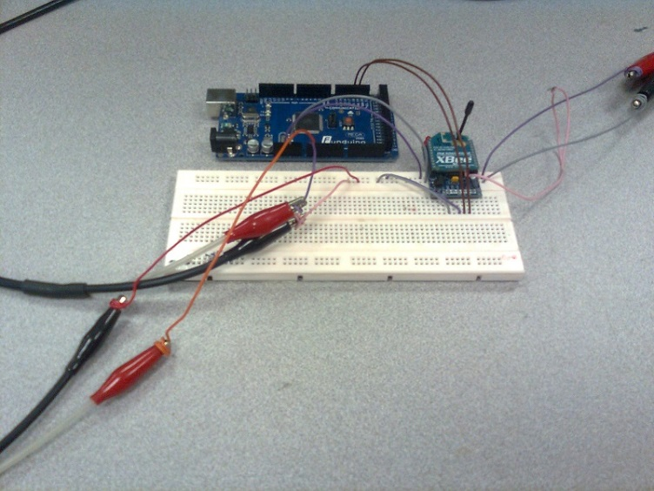
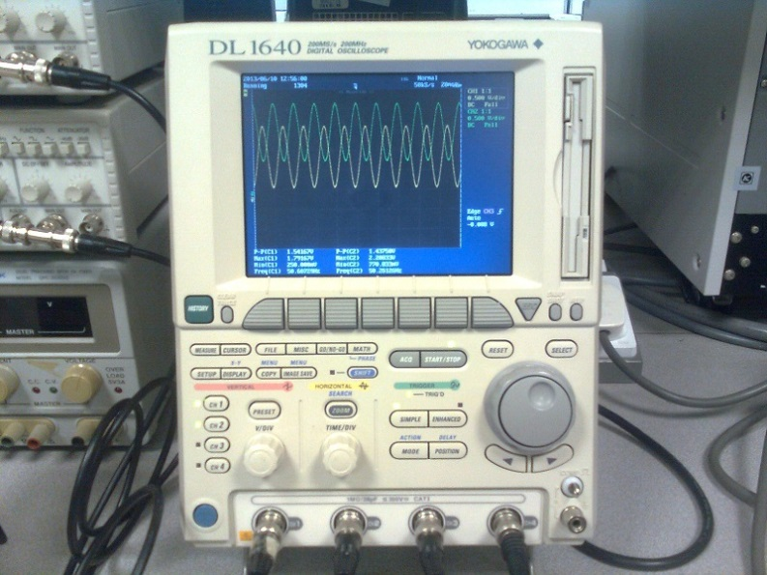
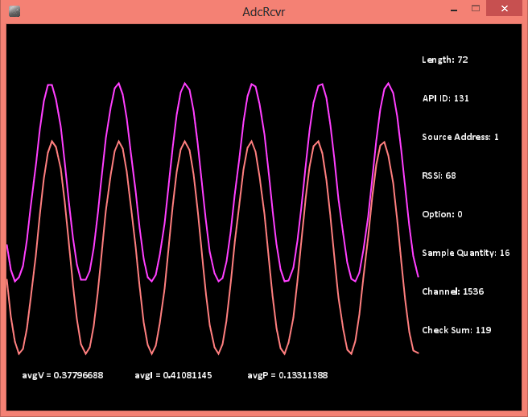
Monitoring Analog Signals wirelessly (using Arduino ADC)

Slide 15
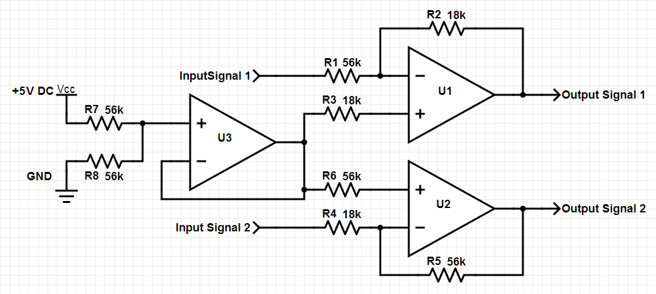
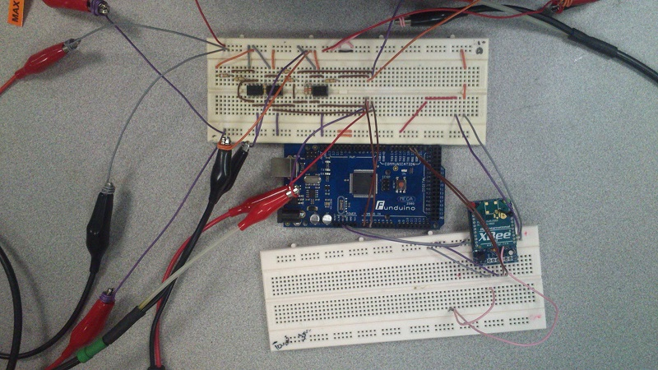
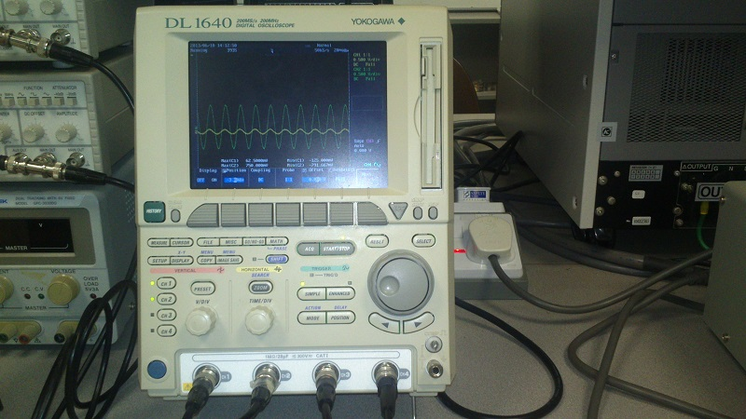
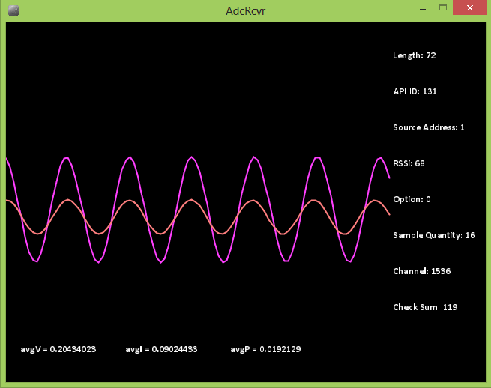
Monitoring Bipolar Analog Signals wirelessly (using Arduino ADC)

Slide 16
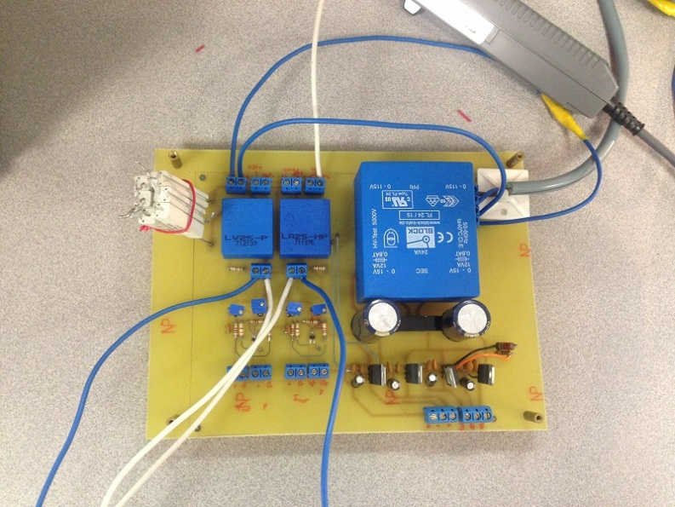
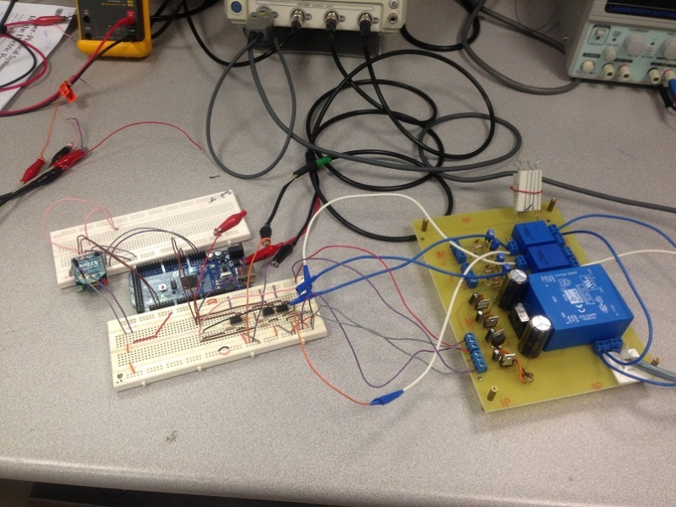
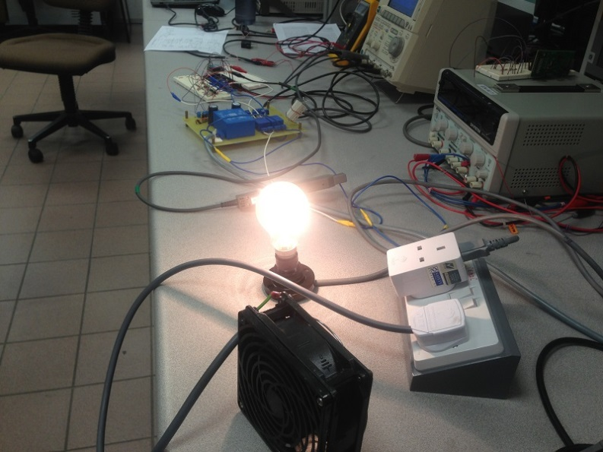
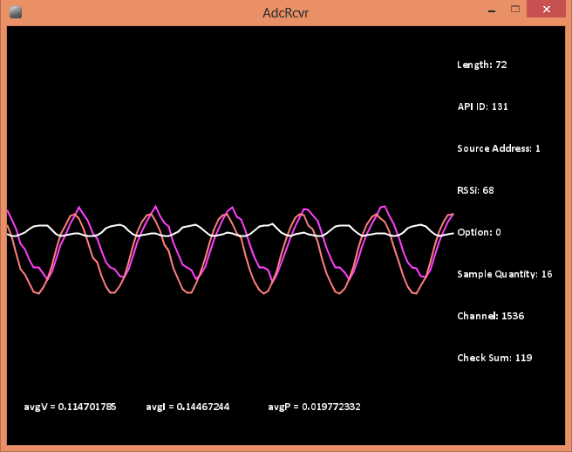
Monitoring Instantaneous Voltage, Current and Power usage on an AC socket wirelessly (using VI sensing circuit & Arduino ADC)

Slide 17
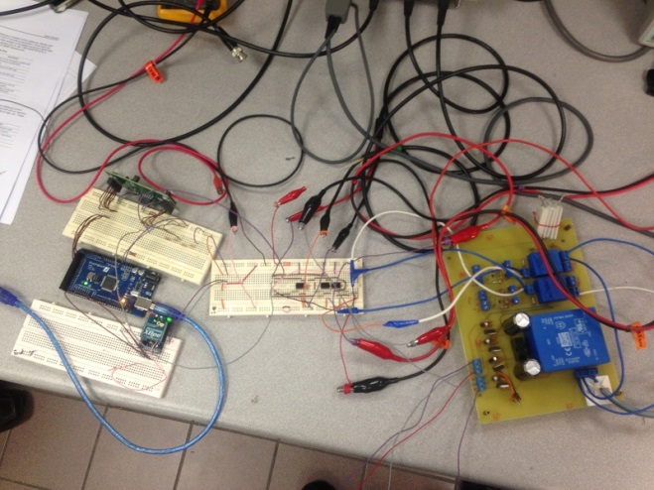

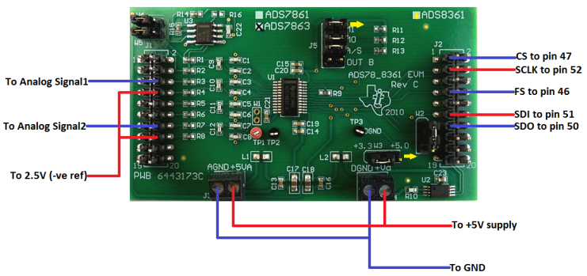
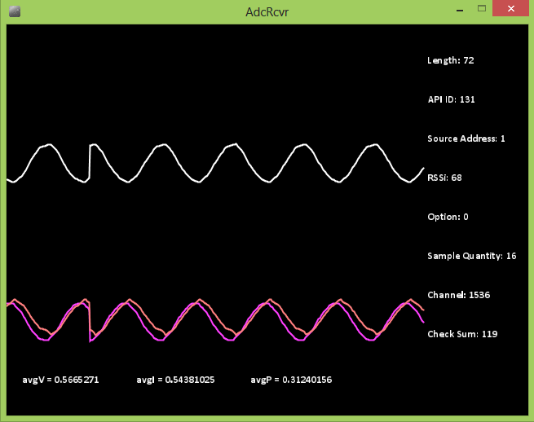
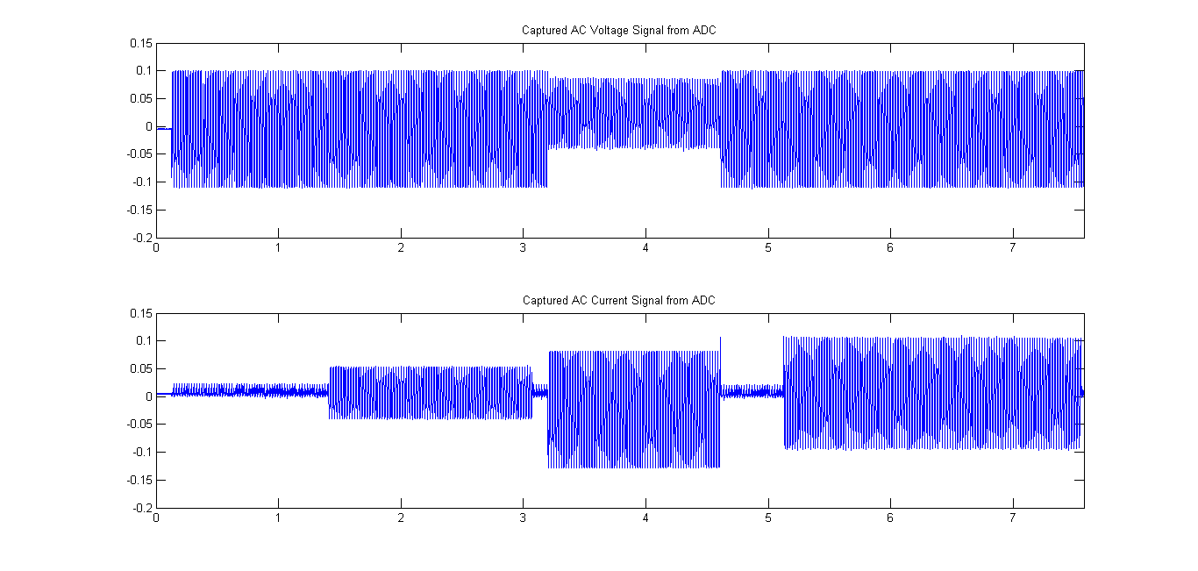
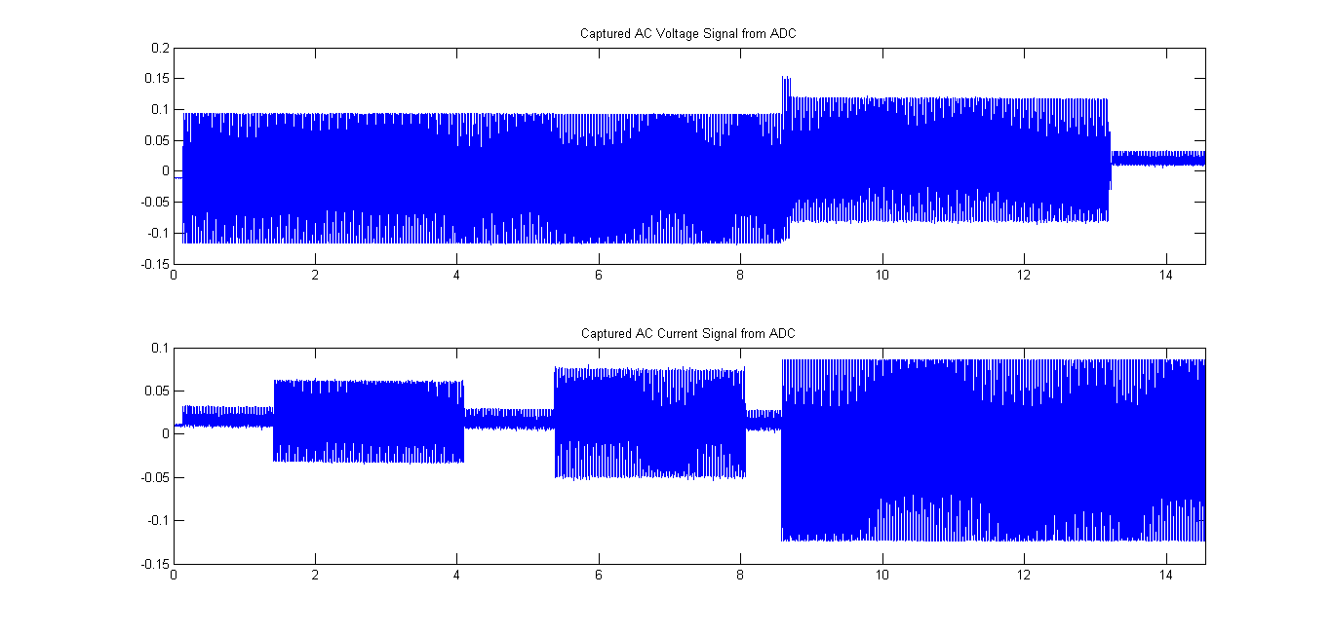
Monitoring Instantaneous Voltage, Current and Power usage with MATLAB on an AC socket wirelessly (using VI sensing circuit & Ext. ADC)

Slide 18
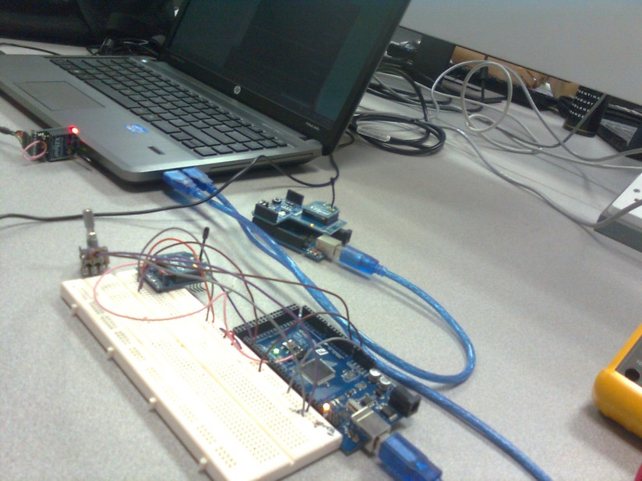
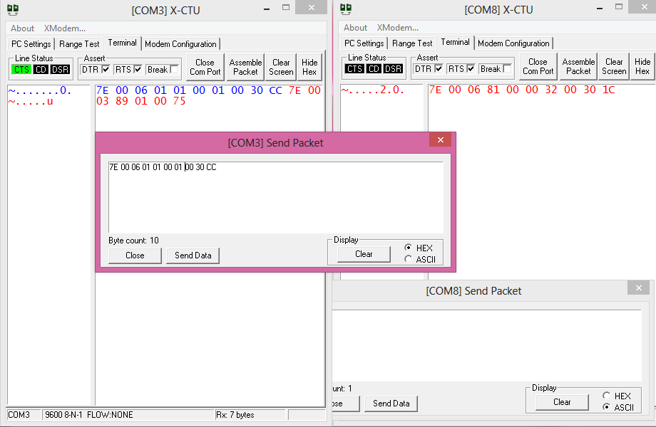
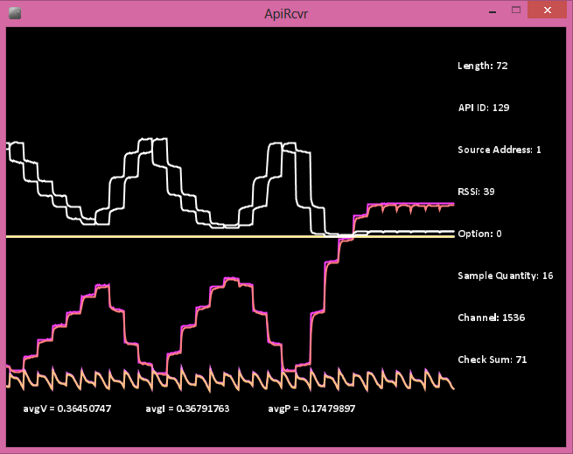
Monitoring Signals from Multiple nodes wirelessly

Slide 19
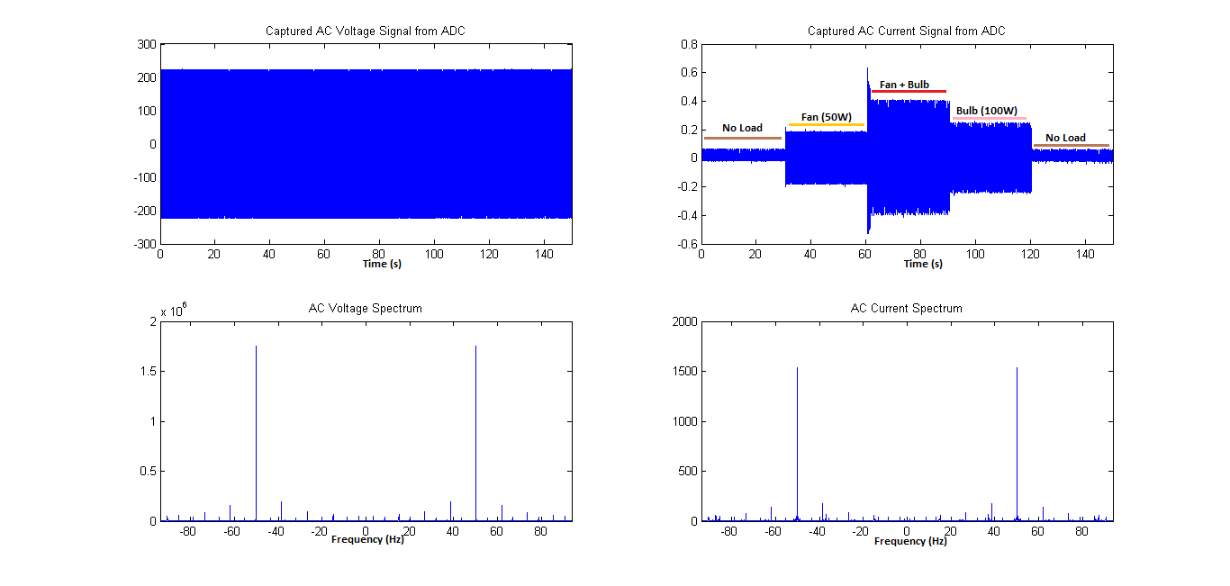
Obtaining spectrum of Voltage and Current in MATLAB

Slide 20
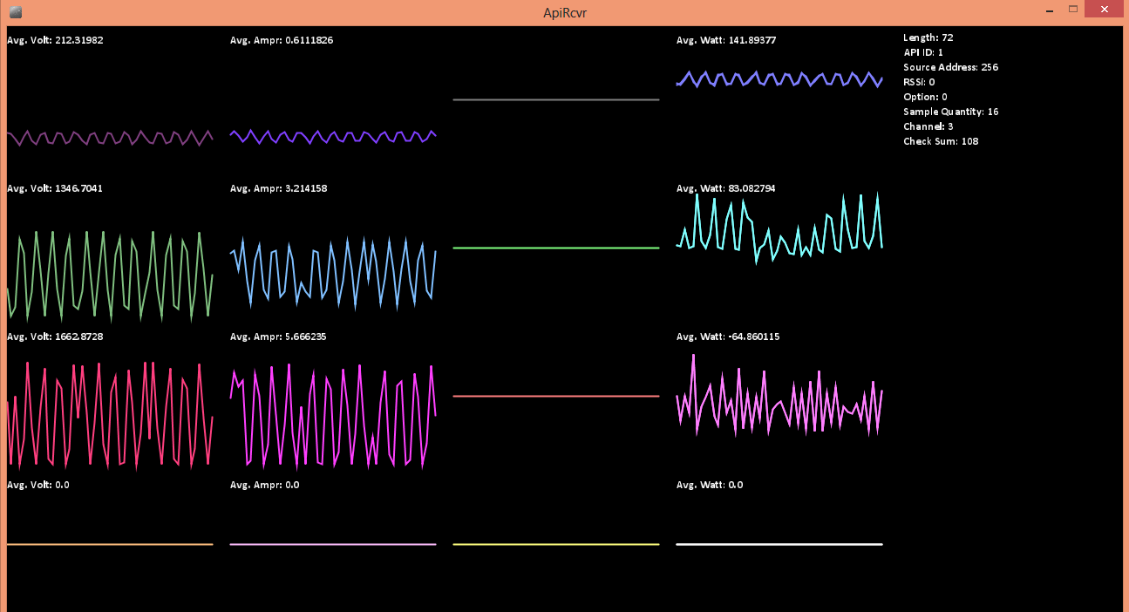
Monitoring Voltage, Current and Power from multiple (3) nodes

Slide 21
Monitoring Voltage, Current and Power from multiple (3) nodes

